Slide 1
ELECTRODIAGNOSTIC TESTS AND INTRAOPERATIVE MONITORING

Slide 2
INTRODUCTION
Evoked response studies are recordings of the nervous system's electrical response to the stimulation of specific sensory pathways (e.g., visual, auditory, general sensory).
Evoked response studies provide information relative to the functional integrity of pathways within the nervous system.

Slide 3
Evoked potentials monitoring can be classified according to the type of stimulation used
1- Visual-evoked potentials (VEPs)
2- Brainstem auditory-evoked potentials (BAEPs )
3- Somatosensory-evoked potentials (SSEPs )
4- Motor evoked Potentials (MEPS)
5- Cognitive evoked potentials (ERPs)

Slide 4
VISUAL-EVOKED POTENTIALS (VEP)
Electrical activity induced in visual cortex by light stimuli
Anatomical basis of the VEP:
Retina
Rods and Cones
Bipolar neurons
Ganglion cells
Optic nerve
Anterior visual pathways
Optic chiasm
Optic tract
Lateral geniculate body
Retrochiasmal pathways
Optic radiation
Occipital lobe, visual cortex

Slide 5
TECHNICAL RECOMMENDATIONS OF VEP STUDY (IFCN)
Channel 1: Oz- Fpz
Channel2 : Oz-A1A2
Ground : Cz
Analysis time:250 ms
No. of epochs at least 100
Stimulation-B & W checkerboard 50-80 % contrast
Size of pattern 14 x 16”
Rate of stimuli-1 Hz (transient), 4-8 Hz (steady state)
Mean luminance of the central field- 50 cd/m2
Background luminance- 20_40 cd/m2

Slide 6
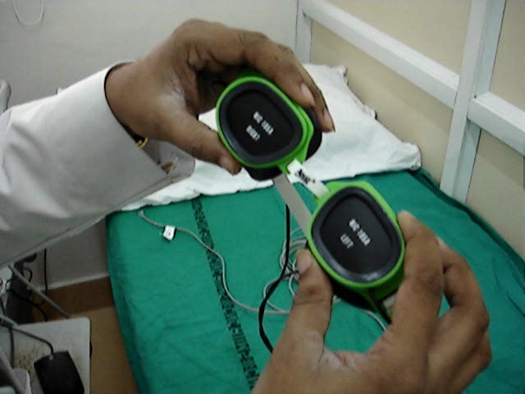

Slide 7
VEP ABNORMALITIES
VEPs represent mass response of cortical and possibly the subcortical areas.
The common waveforms- N75,P100,N145.
Assessment of abnormal VEP
1-Latency prolongation
2-Amplitude reduction
3-Combined latency and amplitude abn.

Slide 8
Normative VEPs
Parameters | Sharokhi et al 1978(mean+_SD)
P100: latency | 102.3+- 5.1
Amplitude (microvolt) | 10.1+_ 4.2
Duration | 63.0+_8.7

Slide 9
ABNORMAL VEP
1-P100 latency prolongation -when P100 Latency is outside the 95th to 99th percentile or when P100 is -not, then VEP considered abnormal
Prolonged P 100 – latency with normal amplitude - demyelination of the anterior visual pathways
2-P100 amplitude attenuation with normal P100 latency - isch. ON causing axonal loss, but P100 amplitude has wide interindividual variability, so less clinical utility .
3-P100 amplitude attenuation with prolonged P100 latency- Optic nerve compression causing segmental demyelination and axonal loss.
4-Inter eye latencies differences- it is useful to look intereye latency diff.,if >10 msec diff-indicate pathology in that eye.

Slide 10
1-Retinopathies and maculopathies-
In maculopathies- patterned ERG are –nt or prolonged. But normal retino cortical time
In optic nerve disease- VEPs may be absent or prolonged but patterned ERG are normal.
In optic nerve disorder with large central scotoma or optic atrophy-both pattered ERG and VEPs –nt.

Slide 11
2-Disorder of optic nerve and chiasma-
VEP are even more sensitive than MRI in detecting lesion and still Ix of choice in suspected demylinating disease of ON.
Temporal dispersion of VEP (diff. in latency b/w N75 and N145 ) are charecteristic of ON compression, but it can be seen in both compression and demylination.

Slide 12
3-Retrochiasmatic Disorders
? Reliability
Full field stimulation are usually normal in pt with u/l hemispheric lesion, but flash or hemi field stimulation pattern can help but not sufficiently sensitive.
VEP – often preserved in b/l retrochiasmatic lesions producing cortical blindness.(ie, generator in extrastiate visualcortex or remnants of cortical area 17.

Slide 13
Newer………Multifocal VEP
Patient views a display containing 60 sectors ,each with checkerboard pattern . It can be used for diagnosing/following ON/MS,and excluding nonorganic visual loss.
It can be combined with multifocal ERG.
Still in infancy stage ? Sensitivity ? Reliability.

Slide 14
CLINICAL APPLICATION OF VEPs
1- Demyelinating disease-(MS)- P100 mean latency is prolonged by 10-30msec..
2-Optic nerve/chiasmatic disease-(AION, nutritional/toxic)
3-Extrinsic compression of anterior visual pathways results in loss of amplitude, distortion of waveform ,and prolongation of P_{100 latency.}
4- VEP has been found to be more sensitive in detecting the compression of anterior visual pathways and found to be abnormal even in a patients with normal visual acuity.

Slide 15
Contd….
5-In cortical blindness-damaged to area 17 with preservation of areas 18 and 19 associated with steady state VEP.
6-Malingering and hysteria-VEP normal in as low vision 20/120
7--Intra-operative monitoring-pituitary ,cavernous sinus tumour, aneurysm surgery.

Slide 16
QUESTION-1

Slide 17
Protocol / Run | N75 | P100 | N145 | P100 | Size
 | ms | ms | ms | µV
L - VEP
1 Oz - Cz | 60.60 | 99.30 | 118.80 | 1.7 | 8
2 Oz - Cz | 65.10 | 93.00 | 108.00 | 2.9 | 8
R - VEP
1 Oz - Cz | 73.80 | 92.10 | 118.20 | 1.9 | 8
2 Oz - Cz | 59.40 | 93.60 | 122.10 | 3.1 | 8

Slide 18
QUESTION-2

Slide 19
Protocol / Run | N75 | P100 | N145 | P100 | Size
 | ms | ms | ms | µV
L - VEP
1 Oz - Cz | 97.20 | 114.30 | 149.40 | 1.8 | 8
2 Oz - Cz | 92.70 | 119.10 | 151.80 | 2.8 | 8
R - VEP
1 Oz - Cz | 95.40 | 119.10 | 152.40 | 2.5 | 8
2 Oz - Cz | 92.10 | 113.40 | 141.60 | 2.4 | 8

Slide 20
QUESTION-3

Slide 21
Protocol / Run | N75 | P100 | N145 | P100 | Size
 | ms | ms | ms | µV
L - VEP
1 Oz - Cz | 64.80 | 99.60 | 126.60 | 7.5 | 8
2 Oz - Cz | 60.60 | 96.30 | 131.10 | 7.6 | 8

Slide 22
QUESTION-4

Slide 24
BRAINSTEM AUDITORY EVOKED POTENTIAL
BAEPs are potentials recorded from the ear and vertex in response to a brief auditory stimulation to assess the conduction through the auditory pathway up to midbrain.

Slide 25
METHODS
Elicited by brief acoustic click stimuli that are produced by delivering monophasic square pulses of 100 microsec duration to headphone /transducer at a rate of 10 Hz.
Stimulus intensity should be loud enough to elicit a clear BAEP waveform -60-65 db
Stimuli are delivered monoaurally.
Electrodes- Fz- ground electrode, Cz-ref electrode, ear lobes- Ai,Ac.-recording electrodes.

Slide 26
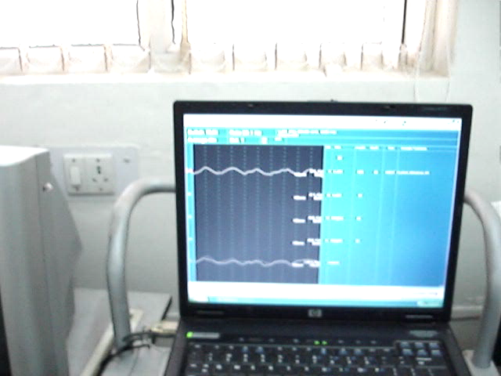

Slide 27
GENERATOR OF BAEPS
Waveform | Generators
I | VIII Nerve
II | Cochlear nu.
III | Superior olivary nu.
IV | Lateral lemniscus
V | Inferior colliculi
VI | MGB, inf colliculus
VII | Auditory cortex

Slide 28
NORMAL VALUES OF BAEPS
Wave (latency ms) | Chiappa et al (1979)
I | 1.7+- 0.15
II | 2.8 +- 0.17
III | 3.9 +- 0.19
IV | 5.1 +- 0.24
V | 5.7+- 0.25
VI | 7.3 +_ 0.29
I-III IPL | 2.1 +- 0.15
III-V IPL | 1.9 +_ 0.18
I-V IPL | 4.0 +_ 0.23
AIIMS , EPS LAB
1.98
4. 16
6.03
2.47
2.16
4.24

Slide 29
ABNORMAL BAEPS
1-Absence of waveforms
2-Abnormal absolute or inter peak latencies
3-Amplitude ratio abnormalities
4- Right to left asymmetry

Slide 30
CLINICAL INTERPRETATION
Assess-
1-Peak latencies of all wave
2- inter peak latencies of I-III,III-IV,I-V
3- IV/V:I amplitude ratio,
4-RT/LT Asymmetry
Limit of normal range-2.5-3 SD from mean of normative data.
Wave- I-if absent –reflect peripheral auditory dysfunction (conductive /cochlear)

Slide 31
Inter peak latencies BAEPs
I-III inter peak latency- reflect abn within neural auditory pathway b/t distal 8th nerve and lower pons , abn in acoustic neuroma /demyelinating/vascular lesion of brainstem.
III –V inter peak latency- reflect abn within neural auditory pathway b/t lower pons and midbrain , but it should be interpretated with IV/V:I amplitude ratio abnormailty.
I-V inter peak latency- reflect abn within neural auditory pathway b/t distal 8th nerve and midbrain.

Slide 32
AMPLITUDE RATIO OF BAEPS
Amplitude ratio IV/V:I amplitude ratio- reflect abn within neural auditory pathway b/t distal 8th nerve and midbrain.
NORMAL VALUE-50-300%
IN CENTRAL AUDITORY DYSFUNCTION- wave V amplitude is low, ratio < 50 %
IN PERIPHERAL AUDITORY DYSFUNCTION-wave I amplitude low , ratio >300%

Slide 33
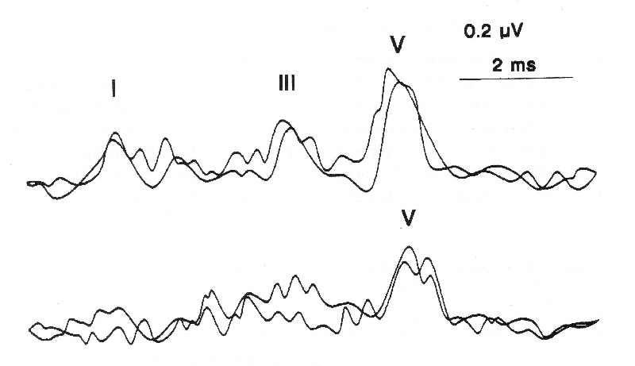
BAEPs
lesion of the lower brainstem

Slide 34
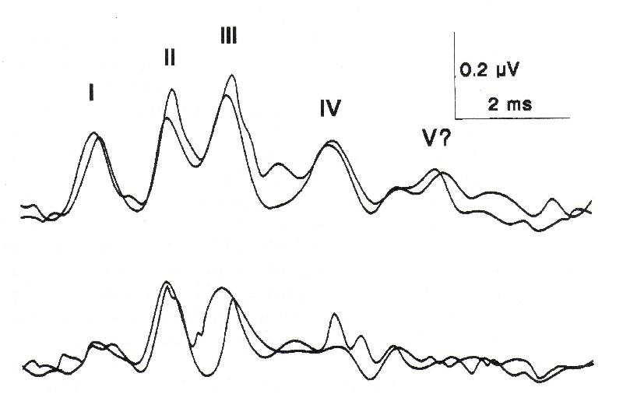
BAEPs
lesion of the upper brainstem

Slide 35
QUESTION-5

Slide 36
Protocol / Run | I | III | V |  | I-V | I-III | III-V | I-I' | V-V'
 | ms | ms | ms |  | ms | ms | ms | µV | µV
L - BAER
1 | 1.56 | 4.02 |  | 5.76 | 4.20 | 2.46 | 1.74 | 0.22 | 0.38
2 | 1.46 | 3.92 |  | 5.66 | 4.20 | 2.46 | 1.74 | 0.12 | 0.72
R - BAER
1 | 1.76 | 4.22 |  | 5.62 | 3.86 | 2.46 | 1.40 | 0.32 | 0.74
2 | 1.78 | 4.30 |  | 5.56 | 3.78 | 2.52 | 1.26 | 0.15 | 0.61

Slide 37
QUESTION-6
What will be the probable site of lesion in this BAER ?

Slide 38
Protocol / Run | I | III | V | I-V | I-III | III-V | I-I' | V-V'
 | ms | ms | ms | ms | ms | ms | µV | µV
L - BAER
1 | 1.46 | 3.10 | 6.90 | 5.44 | 1.64 | 3.80 | 0.43 | 0.30
2 | 1.44 | 3.24 | 6.80 | 5.36 | 1.80 | 3.56 | 0.50 | 0.37
R - BAER
1 | 1.42 | 3.54 | 6.08 | 4.66 | 2.12 | 2.54 | 0.41 | 0.30
2 | 1.40 | 3.54 | 6.38 | 4.98 | 2.14 | 2.84 | 0.44 | 0.49

Slide 39
CLINICAL APPLICATIONS-OF BAEPS
1- Neoplastic -In acoustic neuroma/post fossa tumors-brainstem glioma
2- Cerebrovascular disease- abn in post circ. Stroke involving pontine tegmentum and cerebellar peduncle.
3-Demyelinating disease- 67% with definite MS, 41% in probable MS, 30% in possible MS.
4- Coma/death/locked in state.

Slide 40
BAEP FINDINGS IN CP ANGLE TUMOR
Unrecordable BEAP
Only wave 1 recordable
Prolongation of wave 3 and 5 latency
Prolonged 1-3 and 1-5 IPL
Rt to Lt asymmetry in wave 5 latency>0.5 ms

Slide 41
BAEP IN COMA
In coma following brainstroke ,abnormal BAEP correlated with unstable clinical course and poor prognosis .
Regardless of etiology and depth of coma ,recovery in all patients with normal BAEP and death in all the patient in whom BAEP was unrecordable .

Slide 42
INTRAOP USE OF BAEP
PRESERVATION OF VESTIBULOCOCHLEAR NERVE
AVOID BRAIN STEM INJURY

Slide 43
SOMATOSENSORY EVOKED POTENTIAL

Slide 44
SOMATOSENSORY EVOKED POTENTIAL
SSEPs are the electrical potentials generated mainly by the large diameter sensory fibers in the peripheral and central nervous system in response to a stimulus.
SSEP evaluate the proprioceptive pathways.
Commonly used median and post tibial nerves .
Parameters measured-
1-Latency 2- Amplitude
3-Inter peak latency

Slide 45
METHODS- MEDIAN SSEP
Recording electrodes- placed at erb’s points spinous process of C5,2 cm post. To C3,C4.
Fz – reference electrode
200 uv square wave pulse (5-15 mA with 200 us duration) .Rate of stim-3-8 Hz., 1000 or more epochs to be averaged.
Twice averaged to check for reproducibility.

Slide 46
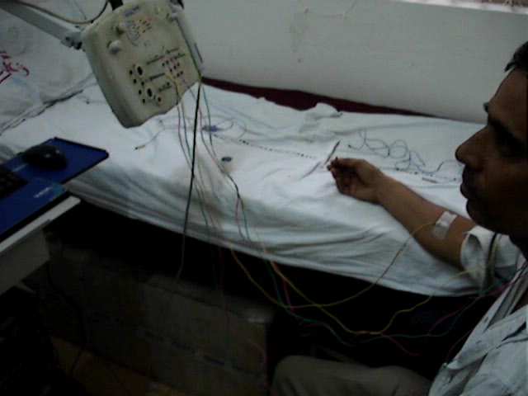

Slide 47
Generators of waveform in Median SSEP
Waveforms | Generators
N9 | Brachial plexus
N11 | Dorsal cervical roots, ascend. Volley in Post column on C5 spinal segment
N13 | Rostral cervical cord
P14 | Medial lemniscus and brainstem collaterals
N18 | Rostral brainstem nuclei, thalamus
N20 | Primary sensory cortex, VPL, nu. Of thalamus

Slide 48
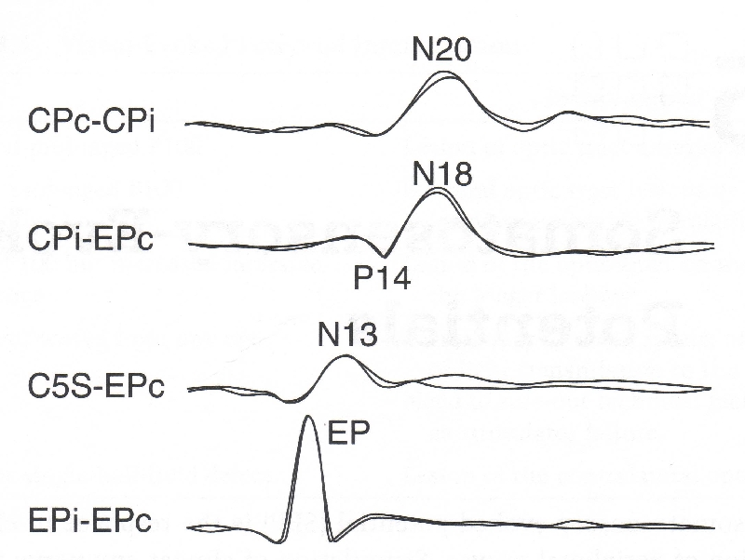
SOMATOSENSORY EPS
Median

Slide 49
Parameters measured-
1-Latency 2- Amplitude
3-Inter peak latency
4- Two Important Interpeak Latencies-
A) Brachial plexus to spinal cord (N9-N13)
B) Central sensory conduction time (N13-N20 )

Slide 50
Normal values of median SSEP
Latency (ms) | IFCN Male –mean UL | IFCN Female –mean UL
N9 | 9.8 (11.0) | 9.2 (10.5)
N20-N9 | 9.3(10.5) | 9.0(10.1)
N20-N13 | 5.7(7.2) | 5.6(7.0)
N13-N9 | 3.5(4.4) | 3.2(4.0)
Amplitudes (uv)
N9 | 4.8(1.0) | 4.8(1.0)
N13 | 2.9(1.0) | 2.9(1.0)
N20 | 3.2 (0.8) | 3.2 (0.8)

Slide 51
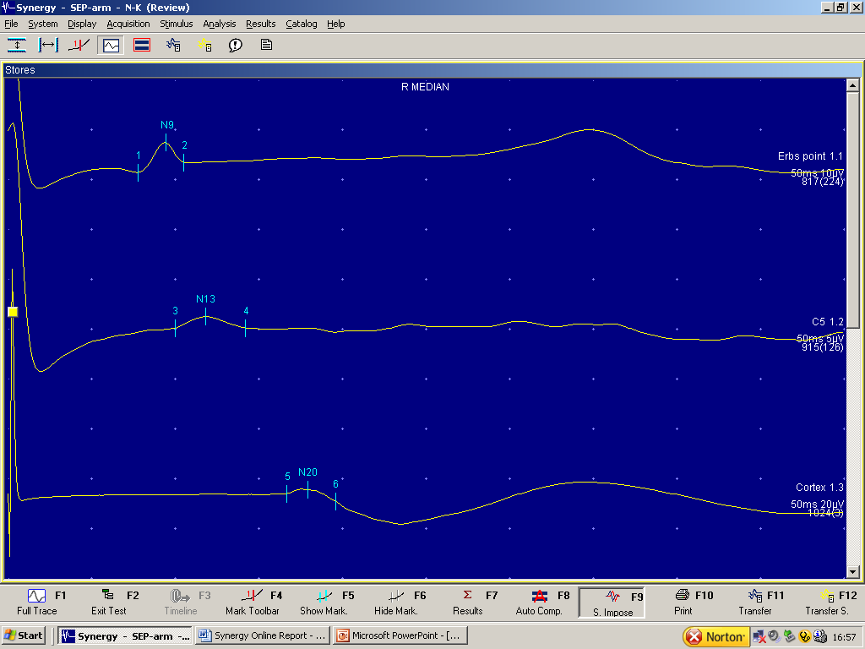
Control-1

Slide 52
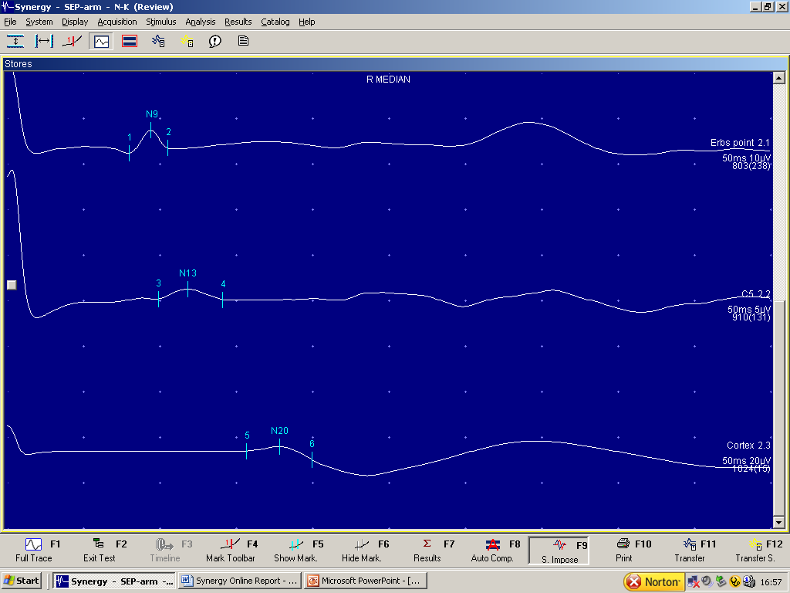

Slide 53
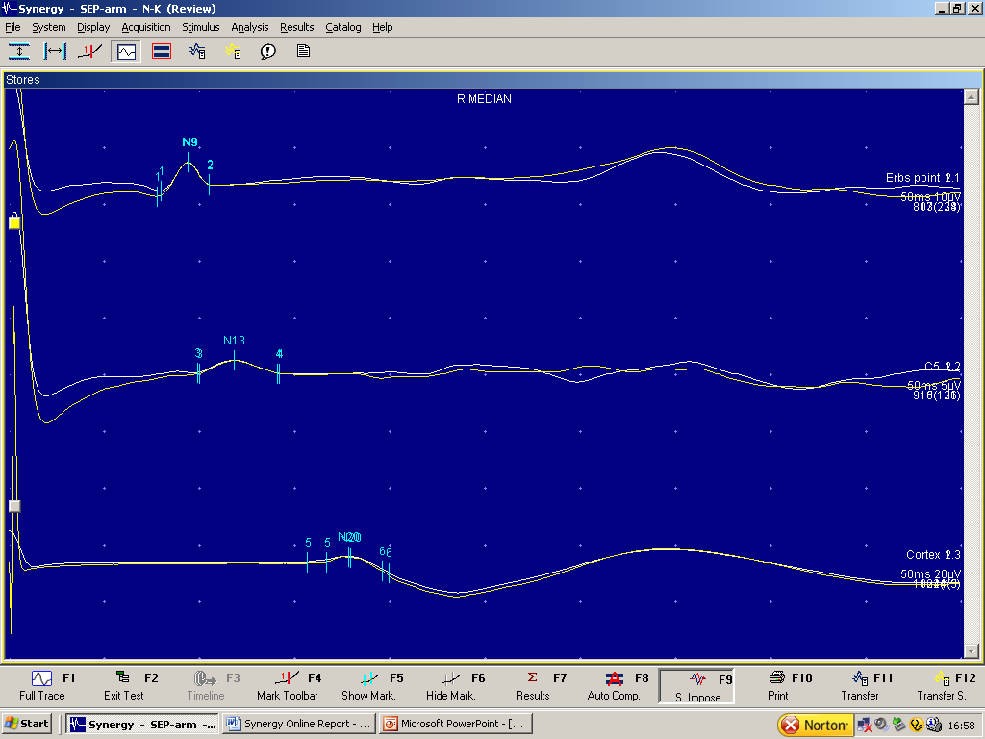

Slide 54
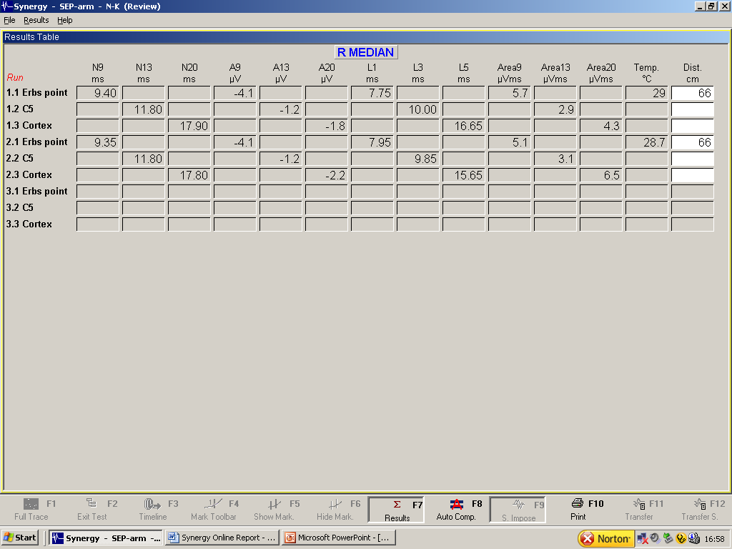

Slide 55
QUESTION-7

Slide 56
Protocol / Run | N9 | N11 | N13 | N20 | P25 | N20 | Low | High
 | ms | ms | ms | ms | ms | µV
L MEDIAN
1 Erbs point | 11.15 |  | 13.30 | 19.05 | 21.95 | 1.2 | 3Hz | Off
2 Erbs point | 11.35 |  | 13.70 | 19.20 | 22.15 | 1.3 | 3Hz | Off

Slide 57
Tibial SSEP
Waveforms | Generators
N8 | Tibial or sciatic nerve
N22 | Dorsal gray matter of lumbar spinal cord
N28 | Cervical spinal cord
P37 | Primary sensory cortex
Ch-1:C’z-Fz
Ch 2:T12-T10
Ch3 :L1-L3
Ch 4:PF-K

Slide 58
Normal values of tibial SSEP
Latency (ms) | IFCN mean UL
N8 | 8.5 (10.5)
N22 | 22.0(24.5)
N37 | 37.5(42.0)
N8- P37 | 28.5(32.0)
N22-P37 | 15.5(18.5)

Slide 59
CLINICAL APPLICATIONS OF SSEP
1-DEMELINATING DISEASE- Diagnostic yield in MS – Abn SEP-60 %, VEP-56%, BAEP- 32% (chiappa. 1983)
Yield of SEP- more with Tibial (64 % ,than median SEP- 54 %.
2-TRAUMA- Preganglionic lesion- if Erb P. N9 –normal , and spinal N13 -NR or reduced. Abnormalities of both N9,N13 –suggest post ganglionic lesion/ combined .

Slide 60
3-VASCULAR LESIONS– Dejerine roussy thalamic syndrome- SEP increased latency with reduced amplitude of cortical potentials.
SEP changes in intracerebral hemorrhage , -nt SEP in large Hm. Unrecordable SEP associated with poorer motor functions.
4- MYOCLONUS- In cortical myoclonus SEP reveal giant potentials..
5- Spinal cord tumors- extra and intramedullary –SEP abn
6-SURGICAL MONITORING- Scoliosis surgery, CTVS – coarctation of aorta and carotid endarterectomy.
indicator of decrease cerebral blood flow

Slide 61
MOTOR EVOKED POTENTIALS

Slide 62
MEPs
MEP refers to the electrical potentials recorded from muscle, ph nerve , or spinal cord in response to stimulation of the motor cortex or motor pathway within CNS.
MEP are of higher amplitude ,do not require prolonged averaging and easier to carry out.
2 way of stimulation- Electrical/Magnetic
ADV- magnetic stim painless but jerk noise produced., while electrical stim lower cost, more focal stim, relative lack of latency shift on activation, and lack of interhemispheric inhibition.

Slide 63
ELECTRODE PLACEMENT FOR ELECTRICAL STIMULATION
Anode placed 5-7 cm lateral and 2 cm anterior to interaural line. For facial muscle , 9-11 cm lateral and 2-3 cm anterior , For LL & pelvic muscle– 2 cm ant to Cz.
Cathode is placed 7 cm lateral away from anode over vertex for UL and facial muscle, 7 cm post to Cz for LL, and pelvic muscle stimulation.
For spinal stim cathode placed on C7 spine and anode prox. for UL. whereas cathode placed on 1st lumbar spine and anode proximal for LL.

Slide 64
ELECTRODE PLACEMENT FOR MAGNETIC STIMULATION
  In magnetic stimulation-coil positioned knowing the direction of current flow and it should be centered on anodal positions.
  For focal stim 2 type coil- angulated round coil, butterfly or figure of 8th coil.
  Magnetic coil also stim the roots and ph nerve.
  MEP are commonly recorded from the contra lateral UL or LL. common recording site biceps,ADM ,APB in UL and TA, EDB in LL.

Slide 65
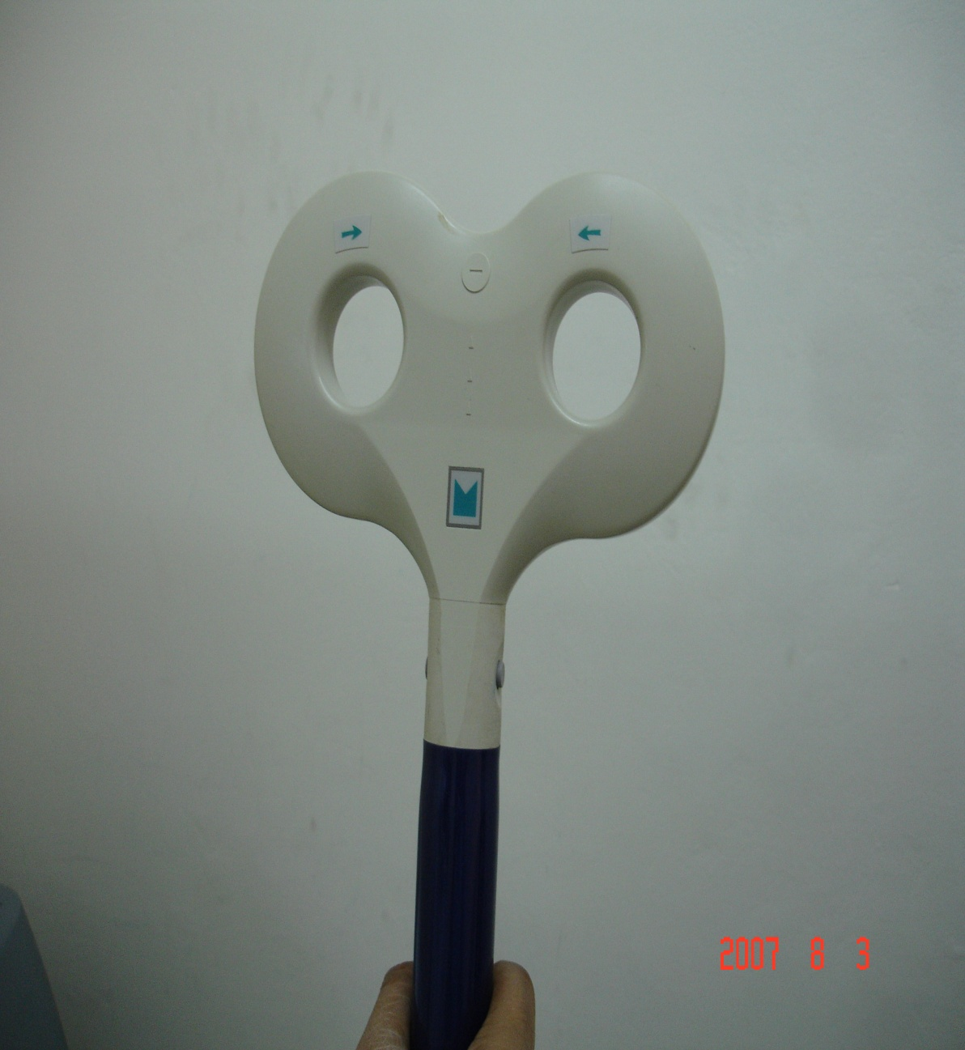
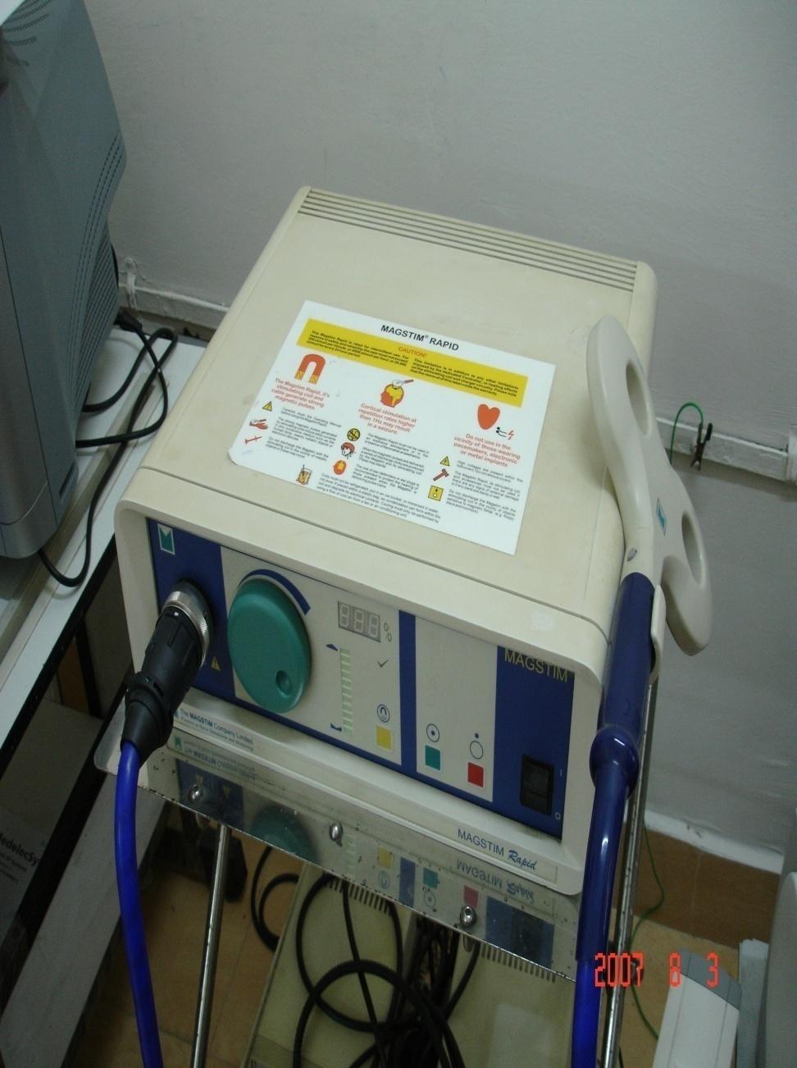
Magnetic stimulator -MAGSTIM

Slide 66
MEASUREMENT OF CMCT
CMCT –measured by subtracting the latency of MEP on spinal stimulation from that cortical stimulation.
CMCT =MEP latency -1/2 (M+F+1)
Where M= latency of direct motor response and F= min latency of F wave.
2 Major Abn of MEP ……..
1-Prolongation of CMCT 2- In excitability of motor pathways.

Slide 67
ANALYSIS
CMCT- difference in the latencies b/t cortical and spinal stim is known as CMCT.
Muscle | Latency (msec) | CMCT (msec)
Biceps | 11.6+_1.2 | 4.9+_ 0.5
Deltoid | 10.6 +_ 1.0 | 4.9+_ 0.5
Thenar | 20.1+_ 1.8 | 6.4+_ 0.3
Tib anterior | 26.7+_ 2.3 | 13.2+_ 0.7
Anal sphincter | 22.8+- 3.6 | 13.3 +_2.3

Slide 68
Clinical application Of MEPs
IN HEAD AND SPINAL INJURY
Documenting motor deficit
Prognostic significant
Intra op monitoring
Demylinating disease
Degenerative disease-MNDS
Inflammatory disease

Slide 69
COGNITIVE EVOKED POTENTIALS
OR
ENDOGENOUS EVENT RELATED POTENTIALS

Slide 70
COGNITIVE EVOKED POTENTIALS
These are long latency evoked potentials related to cognitive processing .
Endogenous evoked potentials have a longer latency, higher amplitude, and lower frequency.
It requires patient’s attention and cooperation.
P3 elicited by unexpected or infreq (target)stimulus in random pattern.
Recent study- P3a generate from frontal area & insula , P3b- from parietal and inf. temporal area form- N1,N2,P2,P3

Slide 71
P3 or P300
Electrodes – Recording- Fz, Cz, Pz, Ground -Fpz , Referred to link mastoid, ear, nose.
Wave form- N1, N2, P2, P3
P3 -Symmetric wave max over midline, central, parietal regions with a latency varying between 250 ms and 600 ms depending on the stimulus and subject parameters
P3 morphology broad- P3a, P3b
Meseaurement- point of max P3 amp.or Intersectional extrapolation
Normal P3- 346.9+_ 38.1

Slide 72
Clinical applications of P3
  1- Dementia- Abn in 30-80 %. ,But early stage-N
  2- Parkinson –prolonged in demented PD
  3- HIV infection- In ADC N2P3 abn
  4- Psychiatric -Acute schizophrenia… Frontal P3 amp. decreased
  5-Mental retardation-Down, Turner, P -W syndrome- attenuated P3
  6- Nutrition/Toxic/Metabolic Disorder –Prolonged in hepatic and uremic coma (Cohen et al)

Slide 73
Significance of NCV is that the distal latency and conduction velocity measurements are helpful in evaluating the speed of conduction along distal and mid portions of a peripheral nerve.
F wave latency is used for the evaluation of proximal segments of motor nerve.
H reflexes are most useful when peripheral conduction studies are normal; abnormal responses suggests a proximal lesion.

Slide 74
Preservation Of Facial Nerve Function During Operations In CP Angles
Monitoring of contractions of the facial muscles is performed during CP angle operations.
Hand held stimulating electrode ,of short pulses is used.
Recently ,EMG is determined from facial musculatures & recording of movements of the face using electronic sensors ;as these recordings are audible.
Trigeminal nerve stimulation differs from facial nerve.
EMG potentials are able to measure the latencies of the responses accurately.
Bipolar and monopolar electrode can be used.
Electric stimulation should consist of negative impulses of short durations.

Slide 75
ELECTROENCEPHALOGRAPHY
It provides a non invasive method for studying the ongoing or spontaneous electrical activity of the brain.
TYPES OF WAVE FORMS :
Alpha rhythm – it is forms when patient is awake ,but at rest with the eyes closed .it has periodicity of 8-12 hz.
Beta rhythm- is characterized by low amplitude waves with a rhythm faster than 12 hz,most prominent in the frontal region.
Theta rhythm – are seen over temporal lobes bilaterally mostly in older individual, but can occur as a result of focal or generalized ,cerebral dysfunction.
Spikes waves- hace characteristic features and can occur as apart of seizure discharge or interictally in patients with epilepsy.

Slide 76
BISPECTRAL INDEX
The Bispectral Index, that monitors the effects of anesthetics and other pharmaco­logical agents on the hypnotic state of the brain ,by recording EEG.
Several clinical studies, and a growing body of evi­dence from routine users have shown that use of the BIS to manage anesthesia leads to:
less drug usage
faster wake-up in the OR
earlier discharge eligibility from the PACU
higher quality recovery
significant cost savings.

Slide 77
The Bispectral Index is computed real-time using a combination of three analysis steps.
The first step is an EEG pre-processor, which breaks the EEG signal down second by second and marks those segments containing artifact that might arise from movement, EMG or electrocautery equipment. Segments of suppressed EEG are also identified.
The second step is the calculation of the hypnosis/sedation index by combining selected EEG features using the algorithm which was developed as previously described.
In the third step, the hypno­sis/sedation index is modified to better reflect the level of suppression in the EEG.

Slide 78
Frequency Band Frequency Range (Hz)
Very Low Frequencies (Delta) 0-4 Hz
Low Frequencies (Theta) 4-8 Hz
Medium Frequencies (Alpha) 8-14 Hz
High Frequencies (Beta) 14-30 Hz

Slide 79
THANKS

